Slide 1
CS0449: Introduction to System Software
SHINWOO KIM
Shinwoo Kim
Teaching Assistant
shinwookim@pitt.edu
https://sites.pitt.edu/~shk148/
Spring 2023, Term 2234
All Sections
with materials from former CS 0449 Teaching Assistants
Department of Computer Science
School of Computing & Information
University of Pittsburgh
Connecting to Thoth via VS Code
Installing VS Code
Installing the Remote Development Extension
DISABLING FLOCK, C/C++ Extension
Connecting to Thoth
Debugging VS Code/Thoth connections

Slide 2
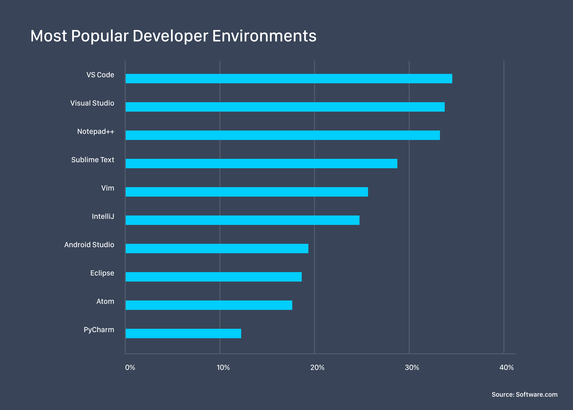
We need for a more robust text editor…
In Lab0, you most likely used a terminal-based text editor, such as Vim, Nano, and Emacs, to write a simple “Hello World!” program on Thoth.
While those programs are great (they really are), once your projects become larger, you’re going to want a more robust text editor…
like Visual Studio Code!
VS Code is a source-code editor made by Microsoft…
and it’s one of the most popular code editors (at least for now)
VS Code is great because:
it supports many languages
it’s cross-platform
has huge library of extensions
And can connect to Thoth (!)
https://www.software.com/src/ranking-the-top-5-code-editors-2019

Slide 3
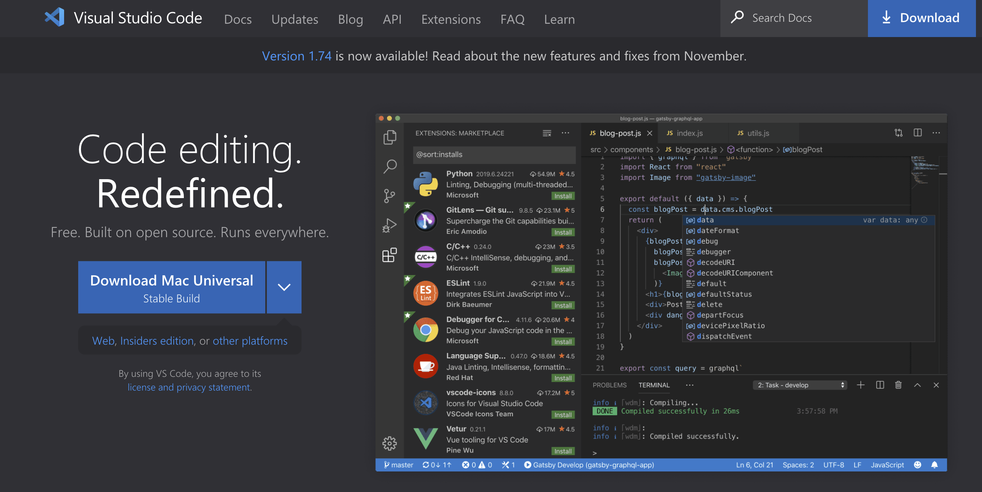
Downloading VS Code
If you haven’t already, you can download VS Code
from https://code.visualstudio.com/
Select ‘Stable Version’ for your platform
Run the installer
Video Walkthrough: https://code.visualstudio.com/learn/get-started/basics

Slide 4
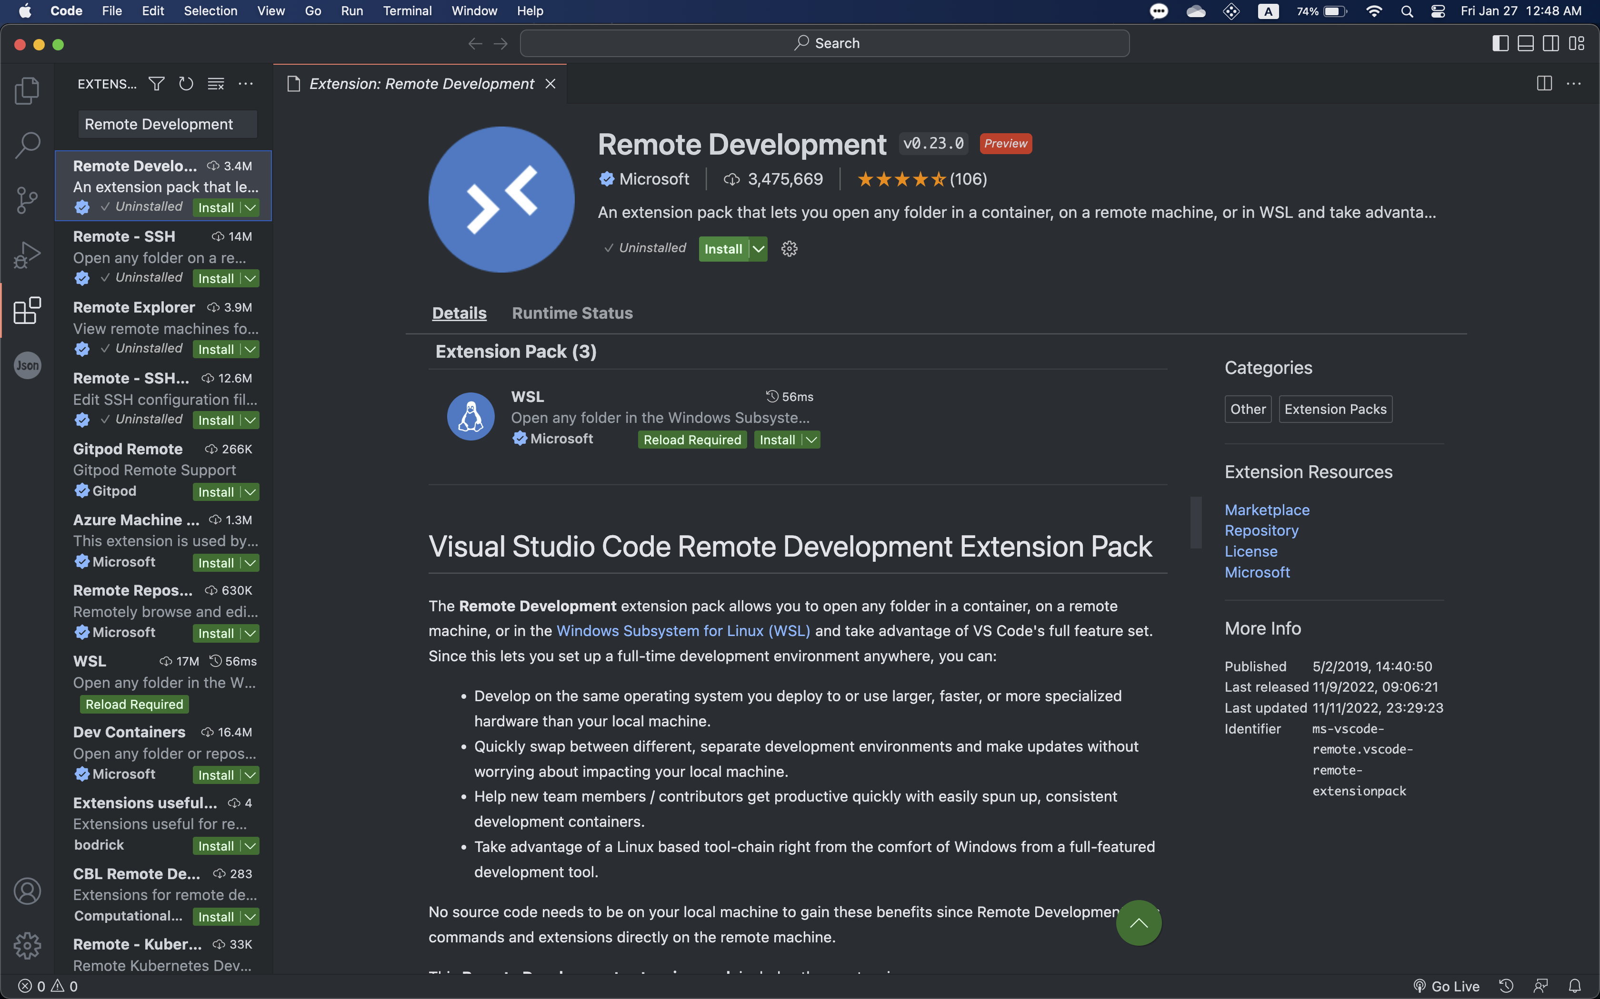
Once you’ve installed VS Code…
You are going to want to install the Remote Development Extension Pack
This extension is what allows us to connect to Thoth
⓷ Install
⓶ “Remote Development”
⓵

Slide 5
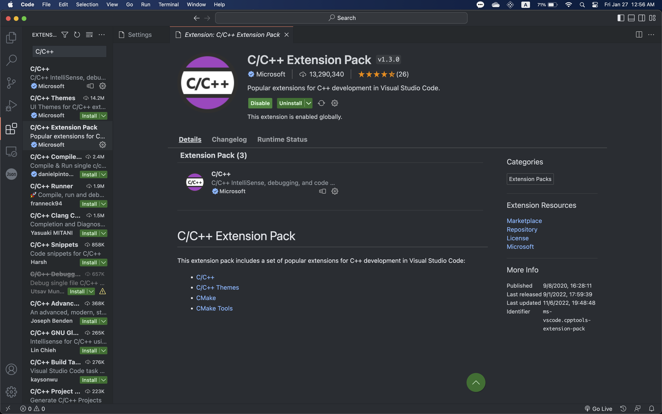
Changing a few settings
While you have the extensions tab open
Search for C/C++ Extension and disable it
Otherwise, you will get errors every time you are programming
C/C++
C/C++ Extension Pack
Disable

Slide 6
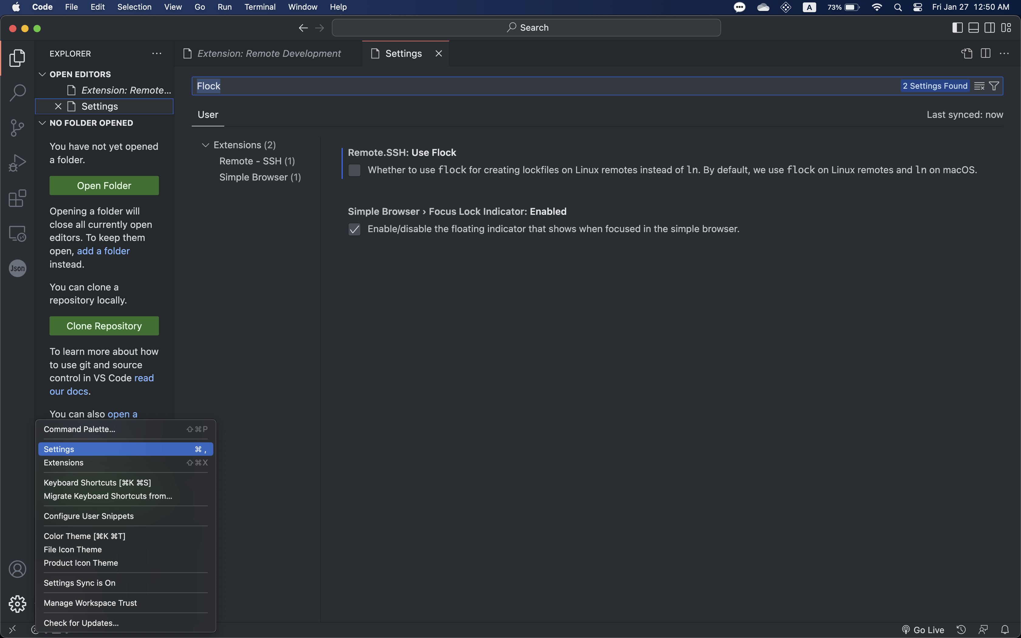
Changing a few settings
Before you connect to Thoth, you need to Disable Flock
If you don’t do this, VS Code will continuously hang on login
And debugging this is a hassle…(really)
⓷ Flock
UNCHECK THIS
⓶ “Settings”
⓵

Slide 7
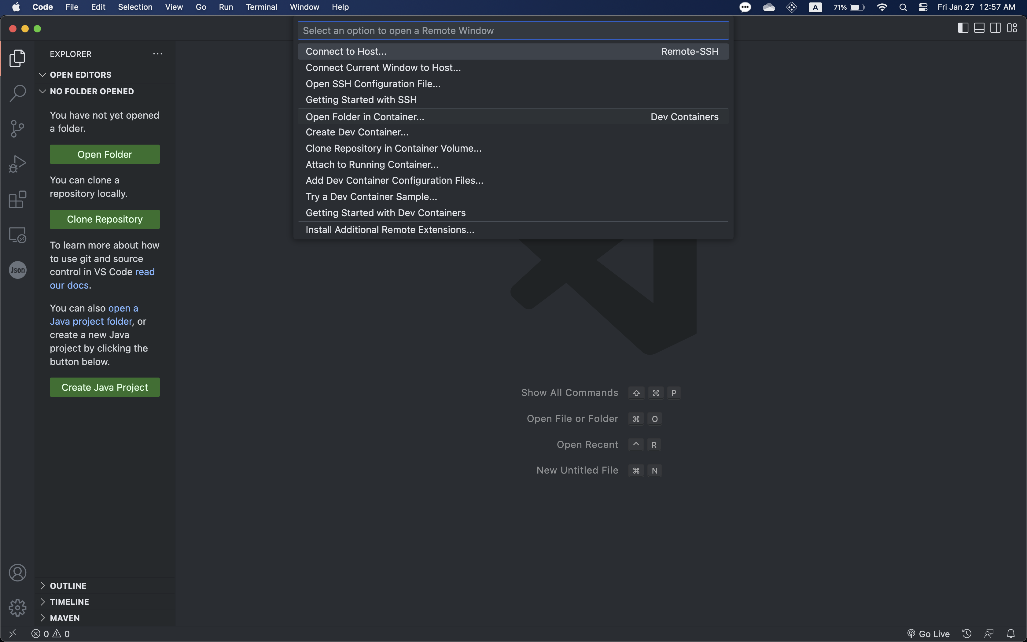
At last, connecting to Thoth
Connect to Host
Type in the box: <pittid>@thoth.cs.pitt.edu
Enter Password and you’re now on Thoth!
Click “Open Folder”
And select the directory you want to work in
It may prompt you for your password again
Click this ><

Slide 8
Debugging VS Code
If you were able to get on Thoth without errors, Hurray!
If you are experiencing errors however:
First, make sure both Flock and C/C++ extension is disabled
Make sure you are able to login to Thoth via ssh (terminal)
And make sure you’re entering your id & password correctly
You may have to kill the VS Code process manually (to restart it)
Log on to Thoth via SSH
Run: kill `ps -ux | grep vscode | awk '{print $2}'`
This command should kill any VS code instances still running on Thoth
Using ls -a and rm –r, remove the .vscode folder on your home directory (of Thoth)
Try logging in again from VS Code
Usually, these steps should be sufficient. However, if you are still experiencing issues with VS Code and Thoth, come visit the TA’s office hours, and we will be able to assist you!

